Slide 1
Topic
Create a road transport database of odisha. Enter all the routes from one city to another city. provide a booking facility

Slide 2
Task done in project
Enter a new bus route
See all the bus routes present
Ticket status and info according to PNR Number
Booking facility

Slide 3
Principles of OOP used
1.Inheritance
2.Encapsulation(Classes and objects)
3.Abstraction

Slide 4
CLASS DIAGRAM
user
ticketinfo
enduser
bookingadmin
bookingofficer
admin

Slide 5
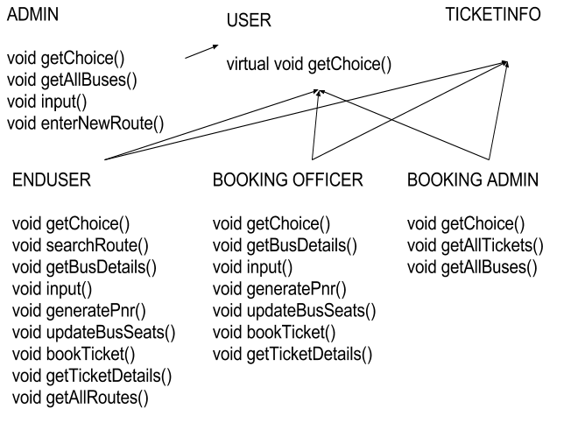
Class Mapping

Slide 6
Inheritance
The capability of a class to derive properties and characteristics from another class is called Inheritance. Inheritance is one of the most important feature of Object Oriented Programming.
Sub Class(child class): The class that inherits properties from another class is called Sub class or Derived Class.
Super Class(parent class):The class whose properties are inherited by sub class is called Base Class or Super class.

Slide 7
Encapsulation
Encapsulation is defined as wrapping up of data and information under a single unit. In Object Oriented Programming, Encapsulation is defined as binding together the data and the functions that manipulates them.

Slide 8
Abstraction
Data abstraction is one of the most essential and important feature of object oriented programming in C++. Abstraction means displaying only essential information and hiding the details. Data abstraction refers to providing only essential information about the data to the outside world, hiding the background details or implementation.

Slide 9
Dynamic Polymorphism
Virtual Functions and Runtime Polymorphism in C++... The main thing to note about the program is, derived class function is called using a base class pointer. The idea is, virtual functions are called according to the type of object pointed or referred, not according to the type of pointer or reference.

Slide 10
Virtual function
A virtual function is a member function that you expect to be redefined in derived classes. When you refer to a derived class object using a pointer or a reference to the base class, you can call a virtual function for that object and execute the derived class's version of the function.

